Slide 1
LIFELONG LEARNING
by
SAQUIB H. SHIRAZI
Mar 14, 2023
Peshawar

Slide 2
Pakistan : A Country With Remarkable Resilience ?
Decade of Development
8 Govt Charges
Decade of Democracy
PTI Govt
Decade of Democracy
PTI Govt
Era of Improved Law & Order
Govt. Change
Operation Radd-ul-Fasaad
US - NATO Exit Afghanistan
Afghan Endgame
Operation Zarb-e-Azb
COVID 19
Election 2018
1960
1965
1970
1975
1980
1985
1990
1995
2000
2005
2010
2011
2012
2013
2016
2021
2022
5.0
4.0
5.9
5% +
Source: State Bank of Pakistan, Economic Survey

Slide 3
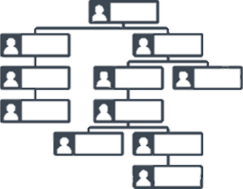
MANAGEMENT DEVELOPMENT
PERFORMER
ORGANISATION BUILDER
STRATEGIST
REVENUE GROWTH
MARGIN
BUSINESS DEVELOPMENT
BREAKEVEN
MCKINSEY 7S FRAMEWORK
CULTURE PRESERVATION
ORGANIZING DEPARTMENT
PRESERVE THE CORE
RECRUITMENT & TRAINING
COMPANY STRATEGY
FINANCIAL STRATEGY
COST DOWN STRATEGY
PRODUCT LINEUP STRATEGY
PRICING STRATEGY
HR STRATEGY

Slide 4
KEY ATTRIBUTES OF A MANAGER
IQ
EQ
SQ

Slide 5
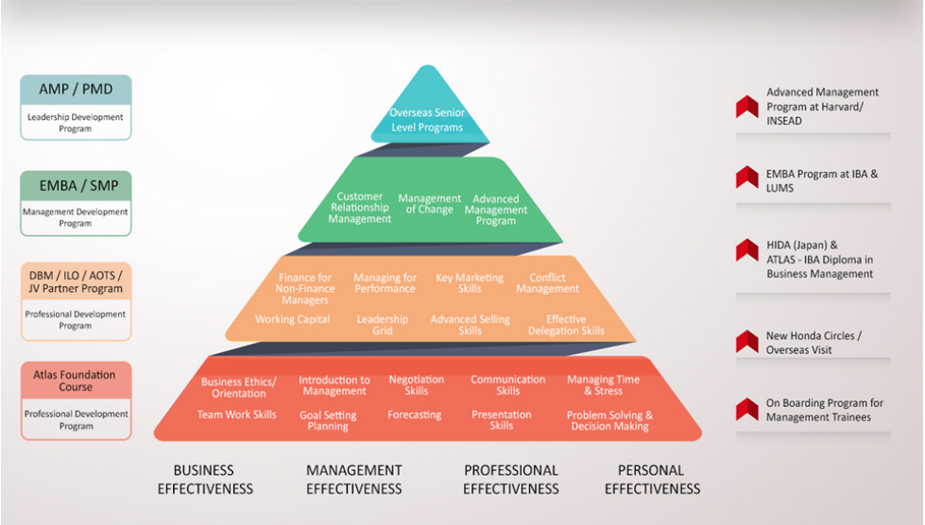
ORGANIZATION DEVELOPMENT THROUGH SELF DEVELOPMENT

Slide 6
Thank You

